Slide 1
Lecture 14
'Trust' – the Foundational Value in Relationship

Slide 2


Slide 3
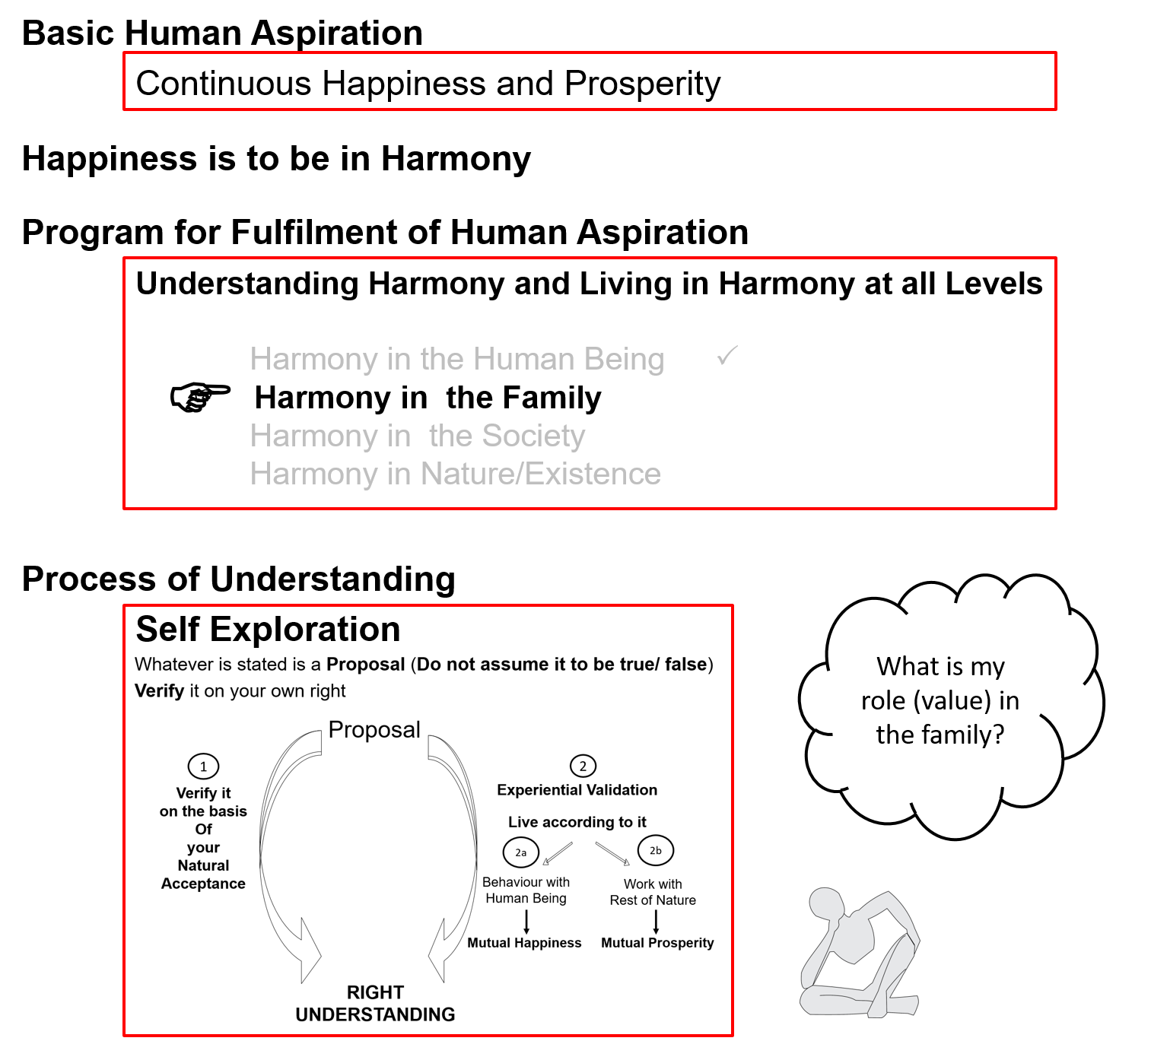

Slide 4
Need to Explore Relationship
We had explored “can we live in relationship without understanding relationship?”
Having right understanding about relationship is necessary for fulfillment in relationship
We had also explored "the unhappiness in our families is more due to lack of physical facility or more due to lack of fulfillment in relationship?”
The major issue in family is that of relationship; physical facility (and body) is used as a means
As long as we consider human being to be body, it is not possible to understand relationship; and without understanding relationship, it is not possible to fulfill relationship, even though we do want to fulfill relationship. We are trying to assume relationship on the basis of body and trying to fulfill relationship on the basis of body, and it does not work, inspite of all good intentions
Now we can explore relationship with the clarity of human being, as co-existence of self and body

Slide 5
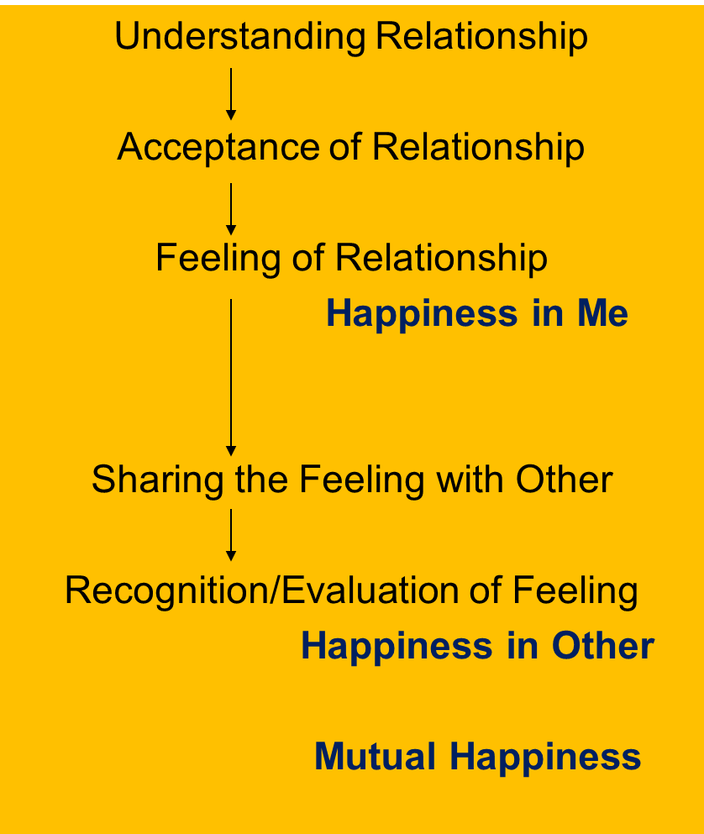
Harmony in the Family
Relationship is – between one self (I₁) and another self (I₂)
There are feelings in relationship – in one self (I₁) for the other self (I₂)
These feelings can be recognized – they are definite (9 Feelings)
Their fulfilment, evaluation leads to mutual happiness
Feelings in relationship:
1- Trust fo”okl FOUNDATION VALUE
2- Respect lEeku
3- Affection Lusg
4- Care eerk
5- Guidance okRlY;
6- Reverence J)k
7- Glory xkSjo
8- Gratitude —rKrk
9- Love izse COMPLETE VALUE

Slide 6
These feelings can be recognized – they are definite (9 Feelings)
Each of us can investigate if these feelings are naturally acceptable to us or not
What is naturally acceptable to you?
  Feeling of trust or mistrust?
  Feeling of respect or disrespect?
  Feeling of affection or jealousy?
  Feeling of care or exploitation?
  Feeling of guidance or misguidance, confusion?
  Feeling of reverence or irreverence?
  Feeling of glory or inglorious feelings?
  Feeling of gratitude or ingratitude?
  Feeling of love or hatred?

Slide 7

Now, we will explore
  1. What is Trust?
  2. Will trust be there for only few persons or for all?
  3. Will trust be conditional or unconditional?
  4. Can we trust anybody in continuity?

Slide 8
Trust (fo”okl)
Trust = to be assured (vk”oLr gksuk)
= to have the clarity that the other wants to make me
happy & prosperous
= nwljk esjs lq[k] le`f) ds vFkZ esa gS] ,slk Li’V gksuk
Now, let us explore this feeling of trust between two individuals
  You are the first individual
  Think of the other as someone in your family… close friends
And let us ask some simple questions…

Slide 9
Evaluating Trust – Between 2 Individuals
About your Natural Acceptance
1a. I want to make myself happy always
2a. I want to make the other happy always
3a. The other wants to make herself/himself happy always
4a. The other wants to make me happy always
About your Ability
1b. I am able to make myself always happy
2b. I am able to make the other always happy
3b. The other is able to make herself/himself always happy
4b. The other is able to make me always happy
√
?
√
?
√
?
?
??
Intention – Natural Acceptance
What is Naturally Acceptable to You
Competence
What You Are (∑ D, T, E)

Slide 10
Doubt on Intention: Mistrust
About your Natural Acceptance
1a. I want to make myself happy always
2a. I want to make the other happy always
3a. The other wants to make herself/himself happy always
4a. The other wants to make me happy always
About your Ability
1b. I am able to make myself always happy
2b. I am able to make the other always happy
3b. The other is able to make herself/himself always happy
4b. The other is able to make me always happy
√
?
√
?
√
?
?
??
Intention – Natural Acceptance
What is Naturally Acceptable to You
Competence
What You Are (∑ D, T, E)

Slide 11
About the Other About Myself
The other broke a glass
If the other makes a mistake even once…
    – I doubt his intention
  – He makes mistakes intentionally
  – I have a feeling of opposition, get irritated, angry…
  – I reinforce “The other is bad”, can not improve
The glass broke by accident
Even if I make the same mistake 100 times…
  – I never doubt my intention
  – I make mistakes by accident
  – I have a feeling “I am special”
  – I reinforce “I am good”. I do not make effort to improve my own competence
Doubt on intention is a major reason for problems in relationships

Slide 12
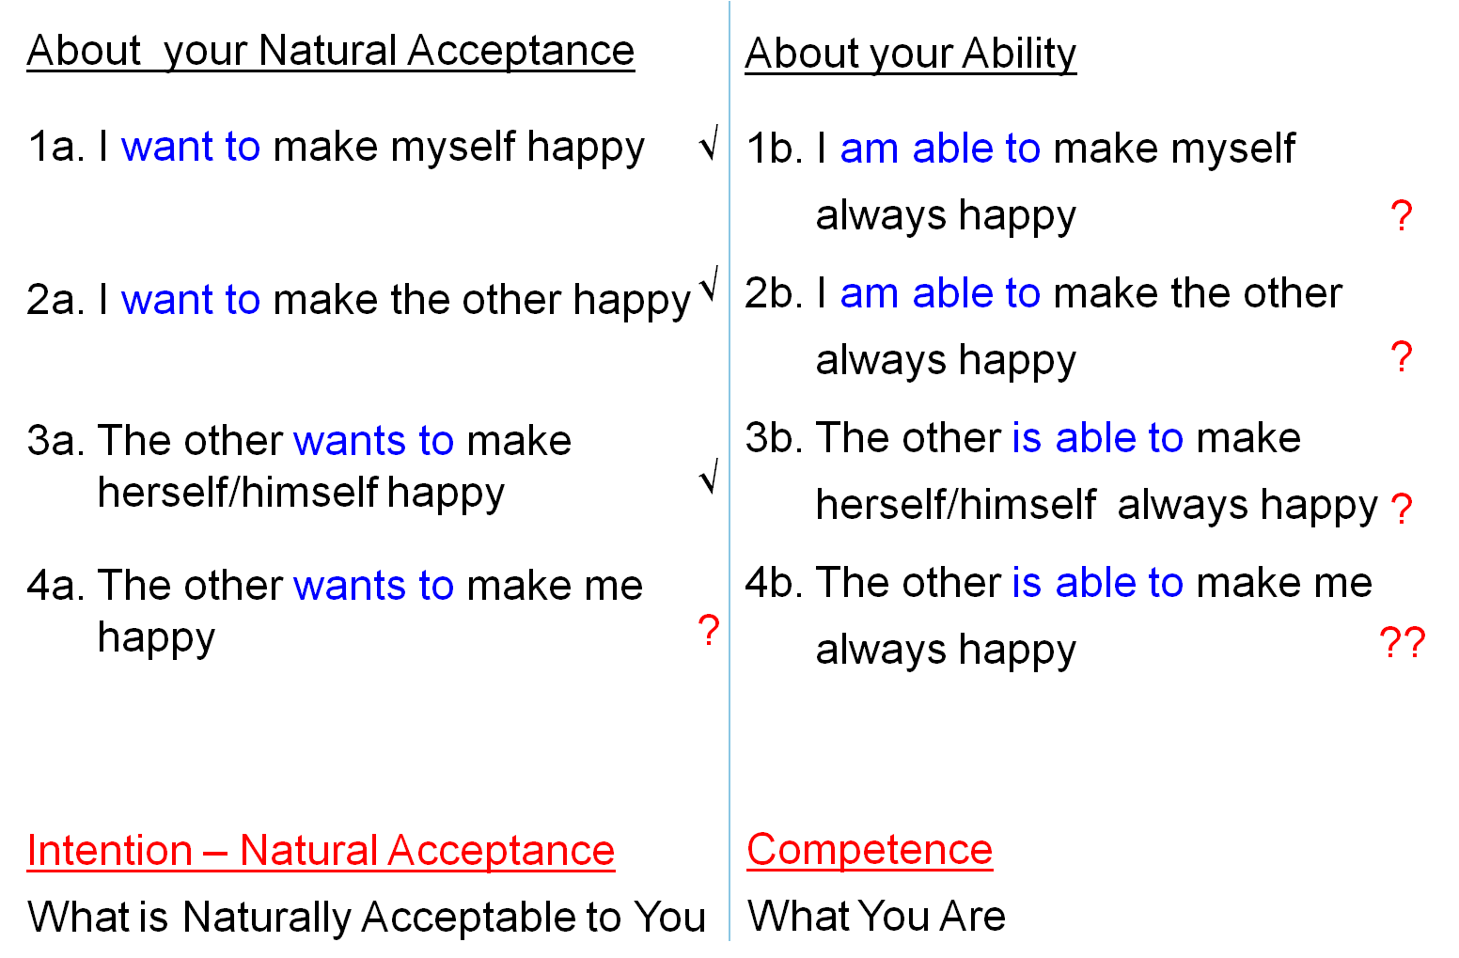
Common Mistake in Relationship
I evaluate myself on the basis of my intention
I evaluate the other on the basis of their competence
I doubt their intention. I assume their lack of competence to be their lack of intention → I feel opposed to the other, I get irritated, angry…
I may not speak to the other for days… or even breakup the relationship… One may have lost many good friends like this…
?
Doubt on intention is a major reason for problems in relationships

Slide 13


Distinguishing between Intention (Natural Acceptance) and Desire
Desire is not the
same as
Natural Acceptance
(only a small set of
Desires may be
guided by
Natural Acceptance…
A larger set of desires
may be motivated by
Preconditioning or
Sensation)
 | Force / Power cy@“kfDr | Activity fØz;k
1. |  | Realization vuqHko
2. |  | Understanding cks/k
3. | Desire bPNk | Imaging fp=.k
4. | Thought fopkj | Analysing fo'ys"k.k
5. | Expectation vk'kk | Selecting/Tasting p;u@vkLoknu
Natural Acceptance
INTENTION
3
Preconditioning
ekU;rk
1
Doubt
on
Intention
COMPETENCE
What You Are
Body 'kjhj
2
Sensation
Lakosnuk
Behaviour O;ogkj
Work dk;Z

Slide 14
Self Reflection
If you have unconditional, continuous trust on intention (natural acceptance) of the other and if the other is lacking competence, what will you do:
  Try to improve his competence (and also improve your competence)
  Get irritated
  Get angry
  Have a feeling of opposition
How many persons, in your family and friends, do you have trust on intention (natural acceptance) – unconditional, continuous?
This is fundamental. Trust on intention is the foundation of relationship
You can get an idea of the state of your understanding about relationship from this exploration…
Trust on Intention → Response
Doubt on Intention → Reaction

Slide 15


Sharing & Questions regarding your Self Reflection
How many persons, in your family and friends
you have trust on intention (natural acceptance)
– unconditional, continuous?
If you have unconditional, continuous trust on intention (natural acceptance) of the other and if the other is lacking competence, what will you do:
  Try to improve his competence (and also improve your competence)
  Get irritated
  Get angry
  Have a feeling of opposition
Trust on Intention → Response
Doubt on Intention → Reaction

Slide 16
Trust: To have the clarity that the other intends to make me happy
About your Natural Acceptance
1a. I want to make myself happy always
2a. I want to make the other happy always
3a. The other wants to make herself/himself happy always
4a. The other wants to make me happy always
About your Ability
1b. I am able to make myself always happy
2b. I am able to make the other always happy
3b. The other is able to make herself/himself always happy
4b. The other is able to make me always happy
√
?
√
?
√
?
√
??
Intention – Natural Acceptance
What is Naturally Acceptable to You
Competence
What You Are (∑ D, T, E)

Slide 17
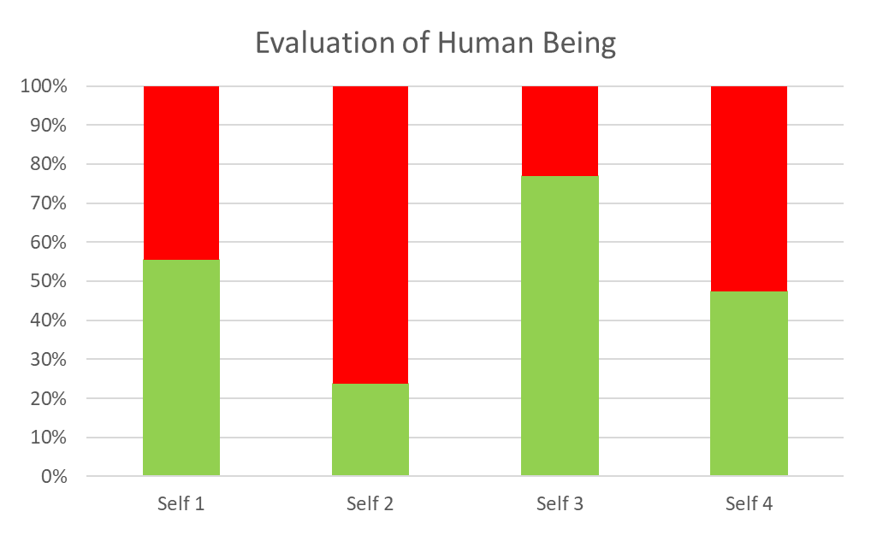
Trust
The Natural Acceptance
(Intention) is
same in every human being
Competence = the % of imagination guided by Natural Acceptance
Competence of various people may be quite different
Lack of Competence
Competence
Me (Self₁) Self_{i} Self_{j} Self_{k}
Take-away:
Trust on Intention (Natural Acceptance)
I am able to see that
the other has a natural acceptance (intention) to make me happy
s(he) may or may not have the competence to do so

Slide 18
About the Other About Myself
The glass broke by accident
Even if the other makes the same mistake 100 times…
    – I am clear about his intention
  – I know the mistake is due to lack of competence, not a lack of intention
  – I make effort to help improve his competence with a feeling of affection
  I know that “he may have difficulty understanding… and also, I may have difficulty in explaining…”
The glass broke by accident
When I make a mistake even once…
  – I am clear about my intention
  – I know the mistake is due to lack of competence, not a lack of intention
  – I make effort to improve my own competence (I am willing to learn)
Trust on intention is the starting point for mutual development

Slide 19
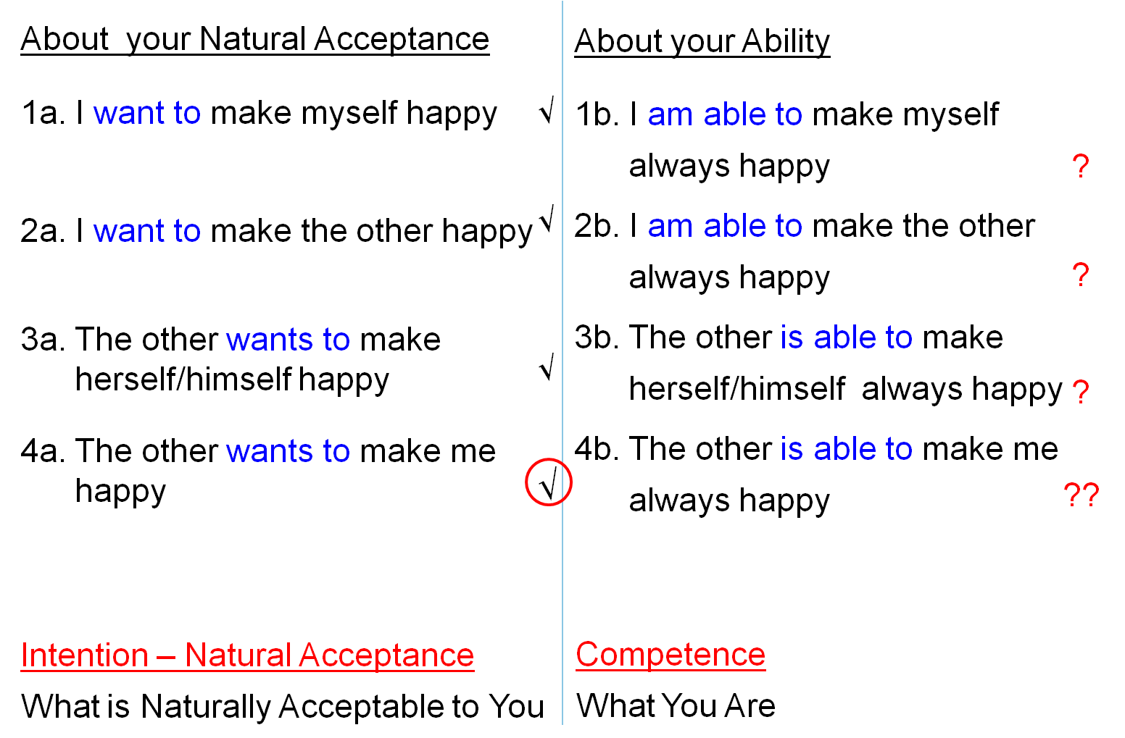
Trust: The Foundation of Relationship
With trust on intention, I feel related to the other (I accept the relationship)
When I make a program with the other
  I evaluate his competence as well as my competence and
  I make the program in accordance with our current mutual competence
I am consistently making effort to learn, to improve my competence
If the other is lacking in competence, I am committed to help the other to improve his competence, without becoming irritated…
Trust on intention is the starting point for mutual development

Slide 20
Understanding Trust Assuming Trust
Being able to see that all human beings have the same natural acceptance (intention) as me
Trust on intention is founded on understanding (not based on events)
It does not keep changing with time or person. So it can be unconditional and continuous
Of course, the competence may or may not be there – in me or in the other
“Trust” on competence is based on events – can keep changing
The last 5 times I lent her money, she returned it on time… so I can trust her
He said he will reach at 11, but look it is after 12 now… he always comes late… so how can I trust him to be on time?
Here we are not looking at the natural acceptance (intention). We are only seeing the competence

Slide 21
Sum Up
Trust is to have the clarity that the other wants to make me happy & prosperous.
Trust is the foundation of relationship
If I am aware of my natural acceptance, I have trust on intention
I feel related to the other (I accept the relationship)
When I make a program with the other, it is based on right evaluation of our mutual competence
  In case the other is lacking in competence
    I make effort to assure the other
    I make effort to improve his competence once he is assured in relationship (and not before that)
  If I lack competence, I become ready to take help from the other to improve my competence
If I am unaware of my natural acceptance, I may have doubt on intention
  I evaluate the other on the basis of his competence and assume the lack of competence to be the lack of intention; and thus feel opposed to him (while I evaluate myself on intention)
  This feeling of opposition shows up as irritation or anger (and it may further lead to fighting, struggle and war)

Slide 22
Self Reflection

Slide 23
Assignment for Today
List the members in your family. Now ask the eight questions regarding trust for each person and evaluate. Get into dialogue if required.
1a. Do I want to make myself happy?
2a. Do I want to make the other happy?
3a. Does the other want to make himself/herself happy?
4a. Does the other want to make me happy?
1b. Am I able to make myself always happy?
2b. Am I able to make the other always happy?
3b. Is the other able to make himself/herself always happy?
4b. Is the other able to make me always happy?
Now evaluate your
intention (natural acceptance) and
level of competence

Slide 24
Self Reflection
How many persons, in your family and friends, do you have trust on intention (natural acceptance) – unconditional, continuous?
  You always make effort to improve mutual competence
  (your own competence as well as the competence of the other)
  rather than getting irritated, angry or having a feeling of opposition
  (even for a moment)
Can you see that the problems in relationship have more to do with lack of understanding relationship rather than with lack of physical facility?
When you have a feeling of opposition, get irritated or angry, observe your desire, thought, expectation – can you observe the doubt you have on the intention of the other?
Can you see your own intention (natural acceptance) clearly?
[Then you can conclude about the intention of the other also]
5. What is the basis for trust on intention…
- Right understanding (of Human Being, Human Relationship…)
- Experience of events

Slide 25
Self Reflection
What is the basis for trust…
- Right understanding of Human Being
- Experience of events
Feeling based on right understanding can be unconditional, continuous…

Slide 26
Self Reflection
What is the role of physical facility
- in understanding trust
- in expressing the feeling of trust
Like this we can find out the role of physical facility in the fulfillment of relationship
Except for the feeling of care, the role of physical facility is not there or is just symbolic

Slide 27
Self Reflection
Where would you start
- expect or demand trust from the other
- make effort to develop the feeling of trust in yourself and
to express it to the other

Slide 28
Key Points
Lecture 14: 'Trust' – the Foundational Value in Relationship

Slide 30
Harmony in the Family
Relationship is – between one self (I₁) and another self (I₂)
There are feelings in relationship – in one self (I₁) for the other self (I₂)
These feelings can be recognized – they are definite (9 Feelings)
Their fulfilment, evaluation leads to mutual happiness
Feelings in relationship:
1- Trust fo”okl FOUNDATION VALUE
2- Respect lEeku
3- Affection Lusg
4- Care eerk
5- Guidance okRlY;
6- Reverence J)k
7- Glory xkSjo
8- Gratitude —rKrk
9- Love izse COMPLETE VALUE

Slide 31
Trust (fo”okl)
Trust = to be assured (vk”oLr gksuk)
= to have the clarity that the other wants to make me
happy & prosperous
= nwljk esjs lq[k] le`f) ds vFkZ esa gS] ,slk Li’V gksuk

Slide 32
Doubt on Intention: Mistrust
About your Natural Acceptance
1a. I want to make myself happy always
2a. I want to make the other happy always
3a. The other wants to make herself/himself happy always
4a. The other wants to make me happy always
About your Ability
1b. I am able to make myself always happy
2b. I am able to make the other always happy
3b. The other is able to make herself/himself always happy
4b. The other is able to make me always happy
√
?
√
?
√
?
?
??
Intention – Natural Acceptance
What is Naturally Acceptable to You
Competence
What You Are (∑ D, T, E)

Slide 33
Trust: To have the clarity that the other intends to make me happy
About your Natural Acceptance
1a. I want to make myself happy always
2a. I want to make the other happy always
3a. The other wants to make herself/himself happy always
4a. The other wants to make me happy always
About your Ability
1b. I am able to make myself always happy
2b. I am able to make the other always happy
3b. The other is able to make herself/himself always happy
4b. The other is able to make me always happy
√
?
√
?
√
?
√
??
Intention – Natural Acceptance
What is Naturally Acceptable to You
Competence
What You Are (∑ D, T, E)

Slide 34
Sum Up
Trust is to have the clarity that the other wants to make me happy & prosperous.
Trust is the foundation of relationship
If I am aware of my natural acceptance, I have trust on intention
I feel related to the other (I accept the relationship)
When I make a program with the other, it is based on right evaluation of our mutual competence
  In case the other is lacking in competence
    I make effort to assure the other
    I make effort to improve his competence once he is assured in relationship (and not before that)
  If I lack competence, I become ready to take help from the other to improve my competence
If I am unaware of my natural acceptance, I may have doubt on intention
  I evaluate the other on the basis of his competence and assume the lack of competence to be the lack of intention; and thus feel opposed to him (while I evaluate myself on intention)
  This feeling of opposition shows up as irritation or anger (and it may further lead to fighting, struggle and war)

Slide 35
FAQs for Lecture 14
'Trust' – the Foundational Value in Relationship

Slide 36
Feelings based on Understanding – Feelings in Me
Understanding Relationship
Acceptance of Relationship
Feeling of Relationship
Happiness in Me
Sharing the Feeling with Other
Recognition/Evaluation of Feeling
Happiness in Other
Mutual Happiness
In me – unconditional, continuous
Expression of feeling
(through Body, as and when required)
→ Harmony in the Family
Role of Education

Slide 37
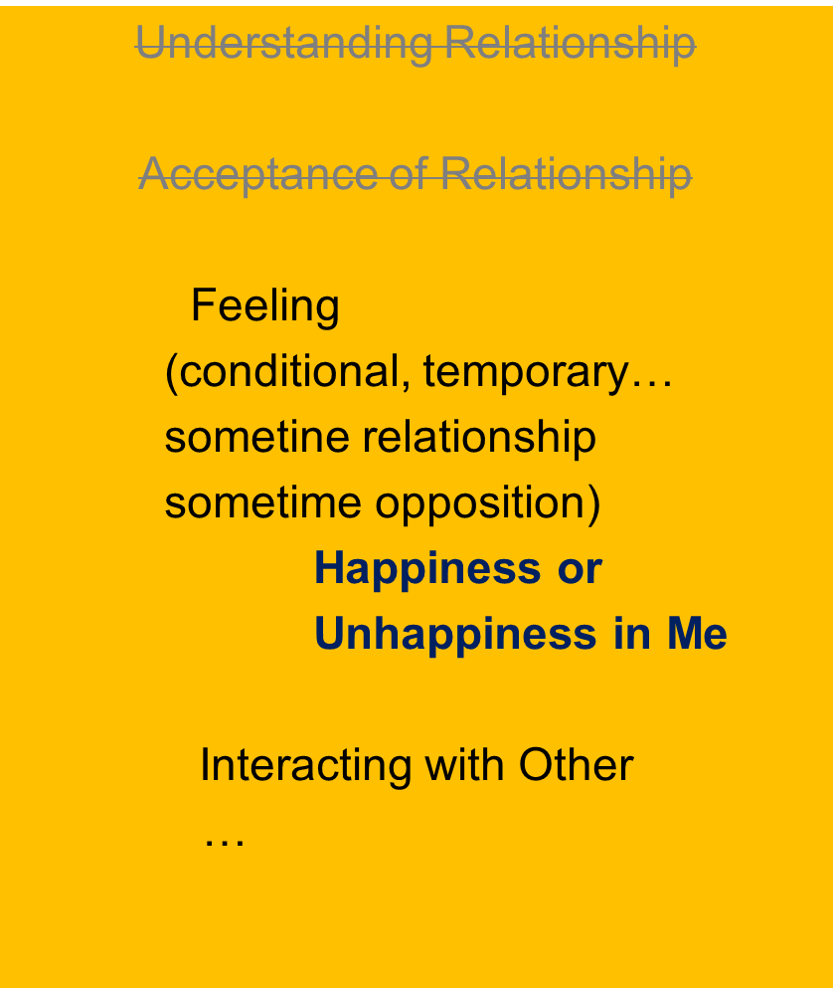
Feelings based on Assumptions, Events – Feelings borrowed from Other
My feelings are conditional,
may change from time to time…
My feelings are decided by
my own assumptions or
outside events / behaviour of other
My state (happiness/unhappiness) is decided/dictated by the other
(I am in a state of enslavement)
Assumptions
Events Outside
Behaviour of Other

Slide 38
Question(s): Intention Response
Does everybody really have the right intention – they could be corrupt people… thieves, rapists, murderers… terrorists…
Intention has to with natural acceptance, and we can see that every human being has same natural acceptance, hence, right intention. However, their competence may be different i.e. their desire, thought, expectation may be different. For example, one may have desire to fulfill others while the other may have desire for exploiting other (at that level they could be corrupt people… thieves, rapists, murderers… terrorists). So, at the level of desires, there may be difference. What we are saying is that we have to have trust on intention but, when it comes to making a program with him, we evaluate our mutual competence and decide for the program on the basis of it.

Slide 39
Question(s): Intention Response
How can we trust everybody, even people we have never met? Isn’t it blindly trusting everyone?
If a person is making the same mistake again and again, even after drawing his attention to the mistake, can we say his intention is right?
What we are saying is that we have to have trust on intention but, when it comes to making a program with him, we evaluate our mutual competence and decide for the program on the basis of it. So, it is not a question of blidly trusting the other, deciding the progrm on the basis of proper evalation of the competence of the other.
Yes. There is problem with his competence; this we can verify for our own case, we have right intention but we keep making many mistakes again and again. Now, we both have to work to improve upon his competence.

Slide 40
Question(s): Trust Response
Don’t you think that if we keep trusting others and quietly keep accepting their behaviour, then they will keep taking advantage of us?
If I start trusting everyone, I will get cheated. I don’t think we should start trusting right away. So my question is, for how long should we observe someone before trusting them?
Quite likely. This may happen to begin with, but slowly the other person will accept your feeling and there will be some space created in the other, then the dialogue can begin and we can together explore into the proposals regarding relationship. Sometime, we may have to be very tough to draw the attention of the other, but that is making the program based on our mutual competence with the feeling of trust on intention. For example, a mother will stop the child from putting his hand in fire by force, but with a feeling of affection.
Till we are able to evaluate his competence properly.

Slide 41
Question(s): Trust Response
If someone you rely on or believe in breaks your trust, how can we keep trusting them continuously? And what to do with them?
As we said, we have to make the program on the basis of proper evaluation of our mutual competence. It is possible that our eveluation may not be correct, and it may have problem. So, we have to work on reevaluating our mutual competence.

Slide 42
Question(s): Helping Other Response
Now I can see the problem with my spouse – s(he) doubts my intention! So what should be my next step?
I have the right intention and I want to help the other to improve his competence, but he does not listen. What should I do?
How many times, for how long should you help the other to improve their competence? 10 times? What if the other does not really want to improve?
An interesting case in a workshop- ‘now, I understand, the problem is that my wife doubts my intention!’ the next step is to have trust on intention of your spouse, and the process may start with it.
You have the intention, but you have to develop the competence. Only when your behaviour is fulfilling for the other that he will feel assured of you and a dialogue will start. Then, he will be ready to listen to you.
It depends on competence of both. If, you find that presently, there is problem with your competence (sanskar) as well as the competence of the other, then it may be better to give time and work on improving one’s own sanskar
from Response and reaction

Slide 43
Question(s): Response
What is the difference between reaction and response?
Reaction and response- described in the next slide

Slide 44
Response Reaction
You decide your feeling on your own right | You decide your feeling based on the behaviour of the other
It is based on right understanding You always have the right feeling It is definite and unconditional The behavior of the other is only an indicator of the state of the other With that input you decide your behaviour to ensure mutual happiness | It depends on whether you like or dislike the (taste of the) behaviour of the other If the other behaves properly, you have a right feeling and may behave properly If the other misbehaves, you have a wrong feeling and you may also misbehave
You decide your own behaviour You are self-organised | Your “remote control” is with the others You are enslaved
Your conduct is definite | Your conduct is indefinite

Slide 45
Question(s): Response
I always thought that desire and intention are exactly the same. Also there is confusion between desire and natural acceptance. Can you clarify these 3 words?
What do you mean by competence? I mean I can find out their skills – is that their competence?
We have already clarified about these there- natural acceptance, intention and desire. Intention has to with natural acceptance, and we can see that every human being has same natural acceptance, hence, right intention. However, their competence may be different i.e. their desire, thought, expectation may be different.
Competence means your desire, thought and expectation that you have accumulated as discussed in the session. Skill is a part of it.

Slide 46
Intention and Desire may be quite different
Intention (natural acceptance), pure
Desire (part of competence) could be motivated by three sources…
Only a fraction of the desires may be in line with intention (natural acceptance)
 | Force / Power cy@“kfDr | Activity fØz;k
1. |  | Realization vuqHko
2. |  | Understanding cks/k
3. | Desire bPNk | Imaging fp=.k
4. | Thought fopkj | Analysing fo'ys"k.k
5. | Expectation vk'kk | Selecting/Tasting p;u@vkLoknu
Natural Acceptance
INTENTION
3
Preconditioning
ekU;rk
1
COMPETENCE
What You Are
Information
Body 'kjhj
2
Sensation
Lakosnuk
Behaviour O;ogkj
Work dk;Z

Slide 47
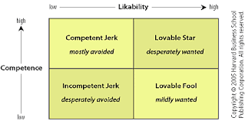
Competence
Competence = Accumulated imagination (desire, thought and expectation)…
(skill is a part of competence, not all of it)
Right evaluation of competence
evaluation of how much of the imagination is motivated by natural acceptance
It includes evaluation of the skills related to work
Contemporary evaluation of competence
evaluation of skill
+
evaluation of attitude / likeability
Reflect: How would you evaluate someone who is
highly skilled, but poor at teamwork?
moderately skilled, but good at teamwork?

